Slide 1
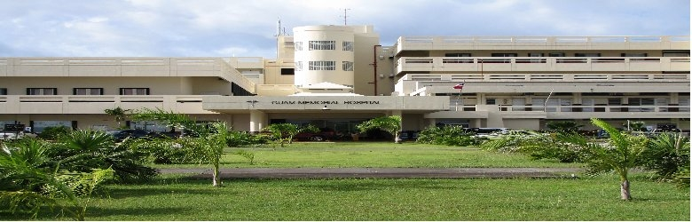
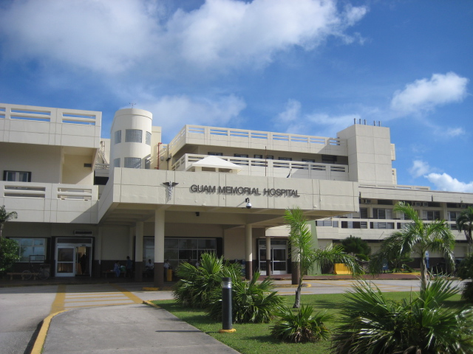

Hafa Adai!
Guam Memorial Hospital Authority
Legislative Informational Briefing
Tuesday, September 21, 2021

Slide 2
Agenda/Topics To Be Covered
GMHA Board of Trustees & Executive Leadership Team
Strategic Plan
  Current Snapshot of CY21 Strategic Goals, Objectives, Milestones
COVID-19 Response Update
Financial Posture & Efforts towards Achieving Financial Stability
Regulatory Compliance: Accreditation/CMS/Risk Mgmt./QAPI
Capital Infrastructure Update
  GMH infrastructure improvements as aligned with ACOE Assessment
  Planning & Development:
    New GMHA Hospital Facility; and
    Alternate Care Facility (at SNF)

Slide 3
BOARD OF TRUSTEES |  |  | EXECUTIVE MANAGEMENT
Theresa Obispo | Chairperson |  | Lillian Perez-Posadas | Hospital Administrator/CEO
Melissa Waibel | Vice-chairperson |  | William N. Kando | Associate Administrator of Operations
Sarah Thomas-Nededog | Secretary |  | Annie Bordallo, M.D. | Associate Administrator of Medical Services
Byron Evaristo | Treasurer |  | Joleen Aguon, M.D. | Associate Administrator of Clinical Services
Sharon Davis | Trustee |  | Don Rabanal | Assistant Administrator of Administrative Services
Sonia Siliang | Trustee |  | Christine Tuquero | Assistant Administrator of Nursing Services
Glynis Almonte | Trustee |  | Liezl Concepcion | Deputy Assistant Administrator of Nursing Services
Michael Um, M.D. | Trustee |  | Yukari Hechanova | Chief Financial Officer
Evangeline Allen | Trustee |  | Danielle Manglona | Administrator of Quality, Patient Safety & Regulatory Compliance
 |  |  | Belle Rada | Assistant Administrator of Professional Support Services

Slide 4
Strategic Plan (2018-2022)
GMHA’s Mission is “to provide quality patient care in a safe environment” (ref. Policy A-110 of the Administrative Manual); and
GMHA’s Vision is “to achieve a culture and environment of safety and quality patient care meeting national standards and addressing the needs of the Community in a fiscally responsible, autonomous hospital” (ref. Policy A-100 of the Administrative Manual).

Slide 5
Strategic Plan (CY2021 Objectives)
No. | Objective Statement | Completion Date
#1 | Achieve/sustain a successful GMHA COVID-19 Response & Recovery throughout CY2021 | 12/31/2021
#2 | Ensure the created/restructured COVID Care Units are maintained in a state of “readiness” for immediate occupancy in the event of another COVID-19 surge throughout CY2021 | 12/31/2021
#3 | Complete and analyze the responses of the Staff Development and Training Needs Assessment survey. | 3/31/2021
#4 | Full implementation and “Go Live” of the MedSphere CareVue EHR Project. | TBD
#5 | Complete the abatement and demolition of the GMH Z-Wing (Abatement completed 8-16-2021; anticipate completing Demolition Design by 10/31/21; and commencing Demo in Q1 of CY2022; parking lot expansion phase to follow Demo Phase). | TBD
#6 | Finish the design phase of the Alternate Care Facility (ACF) plan as approved by FEMA. | TBD

Slide 6
Strategic Plan (CY2021 Objectives)
#7 | Implement an enhanced and robust “Revenue Cycle Management” program to maximize the capturing of income-generating processes/services and monitor/track cost-saving opportunities - dependent on AGO’s review/approval as of GMHA RCM Contract). | 6/30/2021 and Ongoing
#8 | Finalize and secure BOT approval of the hospital/healthcare specific personnel rules/policies with emphasis on the standards of patient care for an Acute Healthcare Facility - dependent on need for Legislative approval. | 12/31/2021 (GMHA phase only)
#9 | Commit/Effectuate active participation in the Health Quality Innovation Network (HQIN) by implementing evidenced-based innovative processes associated with improved patient safety outcomes. | 3/31/2021 and Ongoing
#10 | Complete the A/E Design for the Hospital Roof Repair Upgrade and begin the roof repair project (commended A/E Design Phase 7/30/21; anticipate bidding out Laboratory Roof Upgrade Phase by 11/23/21; and anticipate completion of full Design Package by 1/31/22. | 1/31/2022
#11 | Commence repairing the roof in phases. | 12/31/2021
#12 | Continue collaborating with and engaging GEDA to complete the Conceptual Design Plan for the new hospital facility. | 3/30/2021 & monthly thereafter

Slide 7
Strategic Plan (CY2021 Objectives)
#13 | Explore and begin the engagement of hospital accreditation by a nationally accepted/recognized accreditation organization. | 6/30/2021
#14 | Provide ongoing healthcare training and education programs to Guam to include locally developed and implemented clinical and non-clinical training and education programs; and explore and pursue federal grants and programs for healthcare workforce development and training. | 3/30/2021 & monthly thereafter
#15 | Recruit and retain additional and critical human resources for the divisions of clinical, fiscal, operations and medical services so as to reduce reliance on high-cost/off-island travel nurse staffing agencies. | 3/30/2021 & monthly thereafter
#16 | Inaugurate/Operationalize as a regular practice the Executive Patient Safety Leadership Walk Rounds to all the various patient-care and non-patient-care units. | 1/15/2021 & monthly thereafter
#17 | Conduct quarterly Directors’ and Employee Town Hall meetings. | 3/30/2021 & quarterly thereafter
#18 | Continue the collaborative working relationships with the Executive and Legislative leaders to appropriate funding for the Capital Improvement Plans and Critical Facilities/Infrastructure Plans. | 3/30/2021 & monthly thereafter

Slide 8
Strategic Plan (CY2021 Objectives)
#19 | Complete Communications Center Relocation & Upgrade Project. | 3/30/2021
#20 | Complete CARE Unit #2 (ICU Overflow) Electrical Upgrade for enhanced COVID-19 Response/Recovery. | 4/30/2021
#21 | Complete Annual Maintenance on GMH Main Electrical Distribution Panel in collaboration with GPA. | 6/30/2021
#22 | Complete GMH Boiler #1 Repair (Replace Boiler Tubes). Note: Boiler #2 Repair completed 5/04/2020. | 10/31/2021
#23 | Complete following Medical Equipment purchases: OB Ward Beds (Qty 20) Innovator Health Telemedicine Rounding System Medical/Surgical Beds (Qty 40) ICU Bariatric Beds (ty 2) REDI Kits for Centralized Patient Monitoring (Qty 6; 20 Monitors/Kit) Multipurpose IR/Cardio C-Arm & Renovation (Qty 1) Multipurpose OR C-Arm (Qty 1) | 1/15/2021 2/05/2021 2/10/2021 3/17/2021 4/30/2021 9/30/2021 9/30/2021
#24 | Complete install/commissioning of 2nd & 3rd Sets of Air Handling Units (AHUs) at GMH (Qty 7 / Batch). | 3/30/2022

Slide 9
Strategic Plan (CY2021/2022 Projected Milestones)
By the end of December 2021, 97% of hospital staff will complete the COVID-19 vaccination series.
We will achieve a reduction of the RN “vacancy rate” to 5% thereby increasing our bed capacity throughout all the inpatient care units by December CY2021.
By the end of CY2021, we will achieve a cumulative collection rate of 60% from payers.
By Q2 CY2022, GMHA will launch the new and more effective/efficient Electronic Health Record (EHR)/Electronic Medical Record (EMR) system with a high-interoperability capability throughout the hospital’s clinical and non-clinical services.

Slide 10
GMHA COVID-19 Update
Total COVID Bed Capacity:
Current Census (as of 09-21-2021):
  39 COVID+
  4 PUIs
Total COVID ED Discharges (as of 09-19-2021):
  465+ (Note: *60 for September)
Total COVID Hospitalizations (as of 09-19-2021):
  1223+
Total COVID Deaths (as of 09-19-2021):
  113
  25 were DOA
Total COVID Discharges (as of 09-19-2021):
  1145+
Total Vaccine Program (as of 09-19-2021):
  92.7% fully vaccinated employees
  107 fully vaccinated patients
Description | Staffed capacity | Max capacity | Current Census
CARE1 (ED Overflow) | 5 | 5 | 0
CARE2 (Multipurpose) | 4 | 4 | 0
CARE3 (@ PEDS) | 20 | 20 | 14
CARE4 (@ Tele) | 24 | 24 | 19
CARE5 (@ ICU) | 14 | 14 | 14
CARE6 (@ MS I) | 27 | 27 | 20
PEDS (@ MS II) | 14 | 14 | 7
SURGICAL | 27 | 32 | 31
OB WARD | 17 | 17 | 23
SNF (A & C Wings) | 18 | 40 | 24
Totals: | 170 | 197 | 152

Slide 11
GMHA COVID-19 Update

Slide 12
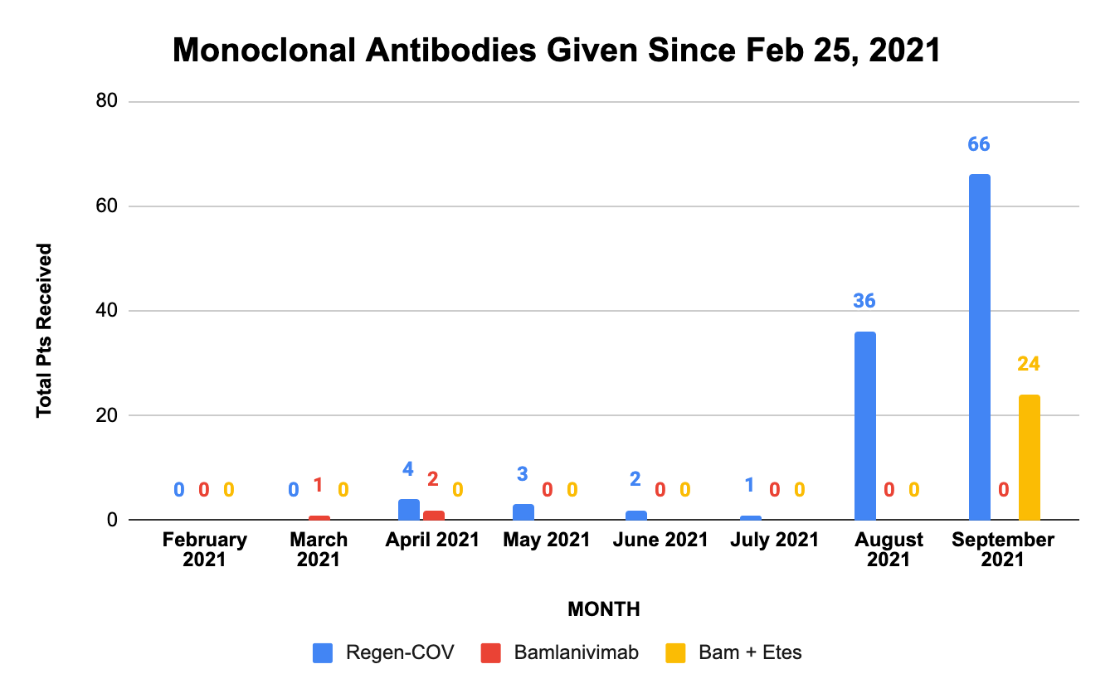
Total Pts Received MAB Medication
MONTH | Regen-COV | Bamlanivimab | Bam + Etes
February 2021 | 0 | 0 | 0
March 2021 | 0 | 1 | 0
April 2021 | 4 | 2 | 0
May 2021 | 3 | 0 | 0
June 2021 | 2 | 0 | 0
July 2021 | 1 | 0 | 0
August 2021 | 36 | 0 | 0
September 2021 | 66 | 0 | 24

Slide 13
Current Financial Posture
    FY 2021 Financials as of 8/31/21
 | 08/31/2021 |  | 08/31/2020 |  | Inc (Dec) | %
Net Revenues | $86.6M |  | $93.2M |  | ($6.6M) | (7%)
Collections | 84.5M |  | 88.2M |  | (3.8M) | (4%)
Operating expenses | 156.5M |  | 126.6M |  | 30.9M | 25%
Federal grants | 26.5M |  | 2.3M |  | 24.2M | 1051%
ER visits and inpatient admissions began increasing in June 2021
August collections increased 68%, or $4.9M from average
Increases in costs for personnel, travel nurses, contract physicians, medications, and PPE
 | 08/31/2021 | 09/30/2020 | Inc (Dec) | %
Cash | $1.3M | $12.1M | ($10.8M) | (89%)
Trade payables | 14.2M | 6.2M | 8.0M | 130%

Slide 14
Current Financial Posture
  CARES Funds & COVID grants received to date:
    $10.3M FEMA (travel nurses)
    $9.7M Provider Relief Funds (HHS)
    $6.1M CARES for COVID-related differential pay, COVID physicians
    $1.9M COVID TAP
    $1.5M CARES for central monitoring equipment

Slide 15
Achieving Financial Stability
    MedHealth Solutions - Revenue Cycle Management consulting services
  Reviewing billing and follow-up processes in detail
  Reviewing GMHA fees with lone Chargemaster staff to submit to Legislature by June 2022
  Assessing medical coding issues and discussing with staff daily to remove roadblocks to timely coding
  Assessing patient registration processes and providing training to staff
 | August 2021 | July 2021
Collections | $12.1M | $7.9M
Average collections | 7.2M | 7.2M
Difference $ | $4.9M | 0.7M
Difference % | 68% | 10%

Slide 16
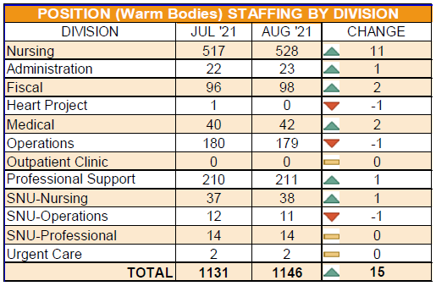
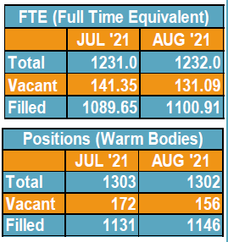
GMHA Staffing Update

Slide 17
Centers for Medicare and Medicaid Services (CMS) & Center for Improvement in Healthcare Quality (CIHQ)
CMS
Acute Hospital:
  CMS certification current
  Last Re-visit Survey: 09/08-09/2021
  Final report pending
Skilled Nursing Facility
  CMS certification current
  Last Re-visit Survey: 09/10/2021
  Final report pending
CIHQ
Applicable to Acute Hospital
Self-assessment ongoing at this time with plan to address any identified issues
Plan for onsite mock survey when current COVID-19 surge trends downward and in coordination with the go-live date of the EHR so as not to overwhelm staff

Slide 18
EHR Implementation Update – 72% Complete
Milestones:
  EHR Build Team Training MAR 2021
  EHR System Build APR – MAY 2021
  Internal Integrated Testing JUN 2021
  Medsphere Integrated Testing JUL 2021
  Net Health (Wound Care) Go-Live AUG 2021
Tasks Pending:
  Integrated Testing Round 2
  Super User Training
  End User Training
Project Paused - Effective Aug 21, 2021:
  95% of project team’s resources refocused to address the surge of COVID and Non-COVID patients
Go-Live:
  To be determined

Slide 19
Capital Infrastructure Update (aligned/guided by ACOE Assessment)
Recently Completed Projects:
  Phase I Implementation of PYXIS (OB Ward, Labor & Delivery, Urgent Care, Medical/Surgical) completed 9-2019; Phase II for 21 other Nursing Units (14 of 21 completed in 2020; Phase III additional areas (e.g., Radiology and SNF) ongoing too.
  COVID Care Units 3 & 4 Electrical and Mechanical Upgrades by ACOE (10-2020).
  Communications Center Relocation & Upgrade Project (3/2021).
  REDI Kits Telemetry Monitoring Upgrades (C-C 3, N-C Tele, C-C 6 and Surgical completed Sept. thru Dec., 2020; ED and COVID Care Units 1, 2 and 5 completed March thru May, 2021.
  Repaired Boiler #2 (5-2020); and anticipate completion of Boiler #1 by 10/31/2021.
  Other FF&E Purchases: Infusion Pumps; BiPAPS/CPAPS; High Flow Nasal Cannulas; Vital Signs Monitors; Hospital Beds; CT Scanner Injectors/Computers; Fetal Monitors; Portable BUV/HEPA Air Purification Systems; Demistifier HEPA Systems; Laboratory Pathology Grossing Station; various IT Upgrade Equipment; and replacement of OR Surgical Lights.

Slide 20
Capital Infrastructure Update (aligned/guided by ACOE Assessment)
  Recently Completed Projects (Cont’d):
    GMHA Telemedicine Program launched 2-05-2021 giving GMHA two avenues to provide Critical Care telemedicine (Innovator Health Physicians Group; Contracted Independent MDs).
      Since the program started we have expanded to 7 Telemed ICU Intensivists, 1 Neonatology, 1 Hospitalist, 1 Rheumatologist and 6 Telemed Technicians.
      Neonatology Consult Service 8/16/21.
      Hospitalist Service started 9/6/21.
      Pulmonology Consult Services started 9/20/21.
      Rheumatology Service is forthcoming.
      Plans for Telemedicine outpatient clinic services forthcoming.

Slide 21
Capital Infrastructure Update (aligned/guided by ACOE Assessment)
CIPs in progress or in the Pipeline:
Main Electrical Distribution Panel/Subpanels
  GMHA & GPA Maintaining Existing Panels (Annual)
HVAC System Upgrades
  Replaced 2 of 64 AHUs; 2nd set of 7 AHUs awarded; and 3rd set pf 7 being procured;
  Completed A/E Design of OR HVAC Upgrade; now packaging Construction Phase IFB;
  Completed A/E Design for ED & ICU HVAC Upgrade and packaging Construction Phase IFB;
  Pending A/E Design Proposal for Radiology Dept. HVAC Upgrade.
Assessing & Maintaining two 1.6 MW and one 650 KW Emergency Generators (Annual)
Assessment & Repair of Boiler #1 ongoing (project completion by end of October 2021)
Hospital Roof & Envelope Upgrade
  Launched A/E Assessment & Design Phase (both A/E Design & Construction Funded by DOI OIA Funds)
IR Room & OR C-Arm Upgrades installation & commissioning in progress (by end of Sept. 2021)
Angio Suite Replacement IFB pending AG Review
Z-Wing Abatement/Design/Demo/Parking
Physician’s Parking Canopy Repair/Upgrade (to complete by end of October 2021)
GMH LOX Tanks Replacement Project
Installation of new OR Surgical Lights in progress (1 of 4 complete pending arrival of lights)
Information Technology Upgrades
Various Medical Equipment Needs
Replacement of Fleet of Vehicles

Slide 22
Planning & Development
Build the New GMHA Facility
  Team Guam Task Force Meetings
  Design Concept Development
  A/E Design Services Phase
  Construction Services Phase
Alternate Care Facility (at SNF in Barrigada)
  FEMA PA Improvement Project (Awarded 12-07-20 @ $15M)
    Medical Pandemic Isolation Facility
    HVAC System, Negative Pressure and Medical Capabilities Upgrades
    Scope includes a bed capacity of 54
  Next Steps Forward
    A/E Design Services Phase(s)
    Construction Services Phase(s)

Slide 23
FACILITY COMPONENTS, DESCRIPTION & STRUCTURE
250-300 Acute Care Beds – Single-Room Inpatient Beds
3-Storey High and 1 or 2-Storey Underground to include Employee Parking, Communications/Command Centers, IT/MIS, Auditorium & Training Rooms, Materials Management & Warehouse, FM Shops, ES Spaces.
Chapel/Meditation/Prayer
Long-Term Acute Care (LTAC)/Long-Term Care Facility (LTCF)/Skilled Nursing Facility
In a separate building adjacent to the hospital an ANNEX for Outpatient Clinics – Cardiology, IV Infusion, Oncology, Orthopedic, Post-Surgery, Primary Care, Pulmonary Care and Rehabilitation Therapy
Veterans Outpatient Clinic
DISID
Morgue and CME Morgue
Viewing Room
Volunteers’ Gift Shop

Slide 24
INPATIENT CLINICAL/DIRECT PATIENT CARE/MEDICAL SERVICES
Anesthesia
Burn Care Unit
Cardiology/Angiosuite
Dietary & Cafeteria
Employee Health & Wellness
ER and Urgent Care Clinic
Infection Control
ICU/CCU/Progressive Care Unit (PCU)
Inpatient Hemodialysis
Laboratory
MCH Units – L&D, OBN/NICU, OBW, Peds/PICU
Medical Surgical & Oncology Unit
Medical Telemetry
Operating Room/Surgery – 6 OR Suites for general surgery, orthopedics, robotics; 1 Procedure room/suite; 1 Cardiac Cath suite; 1 IR
Pharmacy
Quality Management/Utilization Review
Radiology/Interventional Radiology – CT Scan, Fluoroscopy, MRI, Nuclear, PET, Ultrasonography
Rehabilitation Therapy
Respiratory Therapy
Social Services
Special Services
Surgical Unit
Wound Care Program & Hyperbaric Chamber
4-Bed Acute Inpatient “Secured” Care Unit

Slide 25
ADMINISTRATION/OPERATIONS/NON-CLINICAL SERVICES
Administration Office
Accounting/Fiscal
  Medical Records
  Patient Affairs
  Patient Registration
  Payroll
Central Supply
Communications Center
Compliance/Regulatory Office
Education/CME
HR and EEO
Environmental/Housekeeping
Facilities Maintenance
  Biomedical
  Biohazard Waste
Facilities Maintenance – Cont’d
  Carpentry
  Electrical Distribution System
  Grounds Maintenance
  Medical Staff Office
  Utilities/Water System
Guest Relations
Information Technology/MIS
Materials Management/Warehouse
Nursing Administration
Planning
Quality Management/Utilization Review
Risk Management
Safety
Security

Slide 26
Thank you for this information sharing opportunity.

